Slide 1


K.RAMAKRISHNAN COLLEGE OF TECHNOLOGY
(AUTONOMOUS), TRICHY.
DEPARTMENT OF
COMPUTER SCIENCE AND ENGINEERING
20CS5501 DESIGN PROJECT-1
Batch No. : 11
Date : 07.12.2024

Slide 2
AUTOMATIC TIMETABLE GENERATOR
Guided by Team
Mr. G. Rajendra Kannammal, M.E., Sanjay N (811722104130)
Assistant Professor, CSE Santhosh J (811722104133)
Vigneshwaran R (811722104181)

Slide 3
OBJECTIVE OF THE PROJECT
To streamline the timetable creation process by automating the assignment of courses, professors, and time slots, reducing manual effort and errors.
To employ the Greedy Randomized Scheduling Algorithm for optimal utilization of available resources, ensuring balanced workloads and conflict-free schedules.
To provide an intuitive and interactive interface using Java layouts (JFrame and Swing), enabling seamless operation for users with minimal technical expertise.
To allow real-time modifications to schedules without relying on external databases, ensuring the system remains flexible to changing institutional needs.
To offer a modular system that enables administrators to independently create, manage, view, and delete batches, courses, and professors, ensuring streamlined management and customization.

Slide 4
ABSTRACT
The Automatic Timetable Generator is an advanced Java-based application aimed at automating the scheduling process for educational institutions. Developed using Java layouts like JFrame and Swing, the system leverages the Greedy Randomized Scheduling Algorithm to allocate courses, professors, and time slots effectively. Its modular design includes features to create and manage batches, courses, and professors, along with options to view and delete data. The intuitive interface enables administrators to generate and manage timetables dynamically without relying on external databases. By eliminating manual scheduling challenges, the system improves accuracy, reduces administrative workload, and enhances productivity.

Slide 5
LITERATURE SURVEY
TITLE OF THE PAPER | AUTHOR (S) | PUBLISHER | PAPER GIST | TECHNOLOGY USED
Timetable generation algorithms based on Genetic Algorithm | Anisha Jain, Ganapathy S C Aiyer, Harshita Goel | International Journal of Advanced Research in Computer and Communication Engineering | Comparison of Genetic and heuristic algorithms for solving the complex NP-hard timetabling problem. | Genetic Algorithm, Python
Timetable Generation System | Gaurav Kumar, Aishwarya Raut, Apeksha Patel | International Journal of Science, Engineering and Technology | Automated timetable generation using genetic algorithm to reduce complexity and workload. | Web Development, Database, Virtual Queue.
A Study On Automatic Timetable Generator | Parkavi A | International Journal of Innovative Research and Growth | Timetable generation using heuristic, and resource scheduling algorithms to optimize resource usage. | Heuristic Algorithm, Resource Scheduling.
Survey Paper on Automatic Timetable Generator | Ankit Pounikar, Hrushikesh Bhandage, Tanvi Borade, S. H. Lokhande | International Journal of Advanced Research in Computer and Communication Engineering | Automated timetable generation reduces time, and handling complex scheduling efficiently. | Python/Java, Database, Optimization.

Slide 6
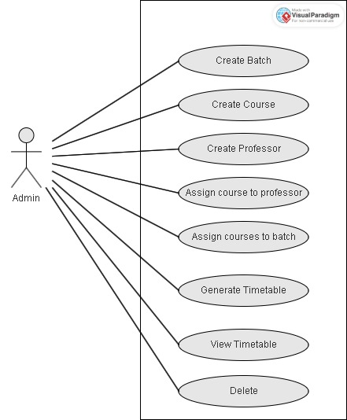
PROPOSED SYSTEM ARCHITECTURE

Slide 7
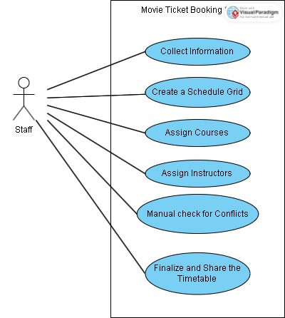
EXISTING SYSTEM ARCHITECTURE

Slide 8
SOFTWARE AND HARDWARE REQUIREMENTS
HARDWARE
SOFTWARE
Programming Language: Java (version 8 or higher)
Visual Studio Code or any IDE (Eclipse, or NetBeans)
Java Libraries: JFrame, Swing
Java Runtime Environment (JRE): JRE 8 or higher
Processor: 2 GHz or higher (Intel Core i3/i5 or AMD Ryzen)
RAM: 4 GB RAM
Storage: 500 MB or more
Operating System: Windows 7 or higher, macOS, or Linux

Slide 9
MODULES
View Page Module
Create Batch Module
Create Course Module
Create Professor Module
Delete Module

Slide 10
SUMMARY OF MODULE-1 VIEW PAGE MODULE
The View Page Module in the Automatic Timetable Generator project is a core component that allows users to dynamically generate and view timetables based on selected criteria. It provides administrators with the flexibility to generate timetables for specific batches or view schedules for individual professors. By selecting a batch, users can view the complete timetable for that group, while selecting a professor’s name displays their personalized teaching schedule. This module streamlines the process of timetable management, allowing users to quickly access the information they need without complex procedures. Its intuitive interface ensures a seamless user experience, making it a vital feature for administrators to effectively manage and monitor the timetables.

Slide 11
SUMMARY OF MODULE-2 CREATE BATCH MODULE
The Create Batch Module in the Automatic Timetable Generator project is responsible for managing the creation and organization of batches. This module allows administrators to define new batches of students, which are essential for generating timetables. When a batch is created, the system provides the option to assign specific courses to the batch. This feature ensures that each batch is associated with the correct set of courses, forming the foundation for the generation of accurate and tailored timetables. The module streamlines the process of batch creation and organization, simplifying timetable management by ensuring that each batch is defined and structured properly.

Slide 12
SUMMARY OF MODULE-3 CREATE COURSE MODULE
The Create Course Module in the Automatic Timetable Generator project allows administrators to define new courses and assign them credit points. This module is crucial for organizing the course structure of the institution and ensures that each course is properly integrated into the timetable generation system. By creating a course, the administrator can provide important details such as the course name and associated credit points. This information is then used to assign the course to specific batches and professors. The module simplifies the process of course creation and ensures that all course data is reflected in the timetabling system, allowing for seamless schedule generation and management.

Slide 13
SUMMARY OF MODULE-4 CREATE PROFESSOR MODULE
The Create Professor Module in the Automatic Timetable Generator project allows administrators to add new professors to the system and assign them to specific courses. This module plays a critical role in the accurate allocation of courses and batches to professors, ensuring that each professor is associated with the correct subjects. When creating a professor, the administrator can input essential details such as the professor’s name, department, and qualifications, which are stored in the system. Additionally, this module allows for the assignment of courses to professors, enabling the system to generate a schedule that aligns with the availability and expertise of the faculty members.

Slide 14
SUMMARY OF MODULE-5 DELETE PAGE MODULE
The Delete Batch Module in the Automatic Timetable Generator enables administrators to remove batches that are no longer needed. By selecting a batch from a list, administrators can delete it, ensuring that outdated or incorrect data is removed from the system. This helps maintain the accuracy and relevance of the timetable data, ensuring the timetable generation process is based on the current and correct set of batches. The module contributes to the overall management of the system, simplifying the process of cleaning up unnecessary or obsolete data.

Slide 15
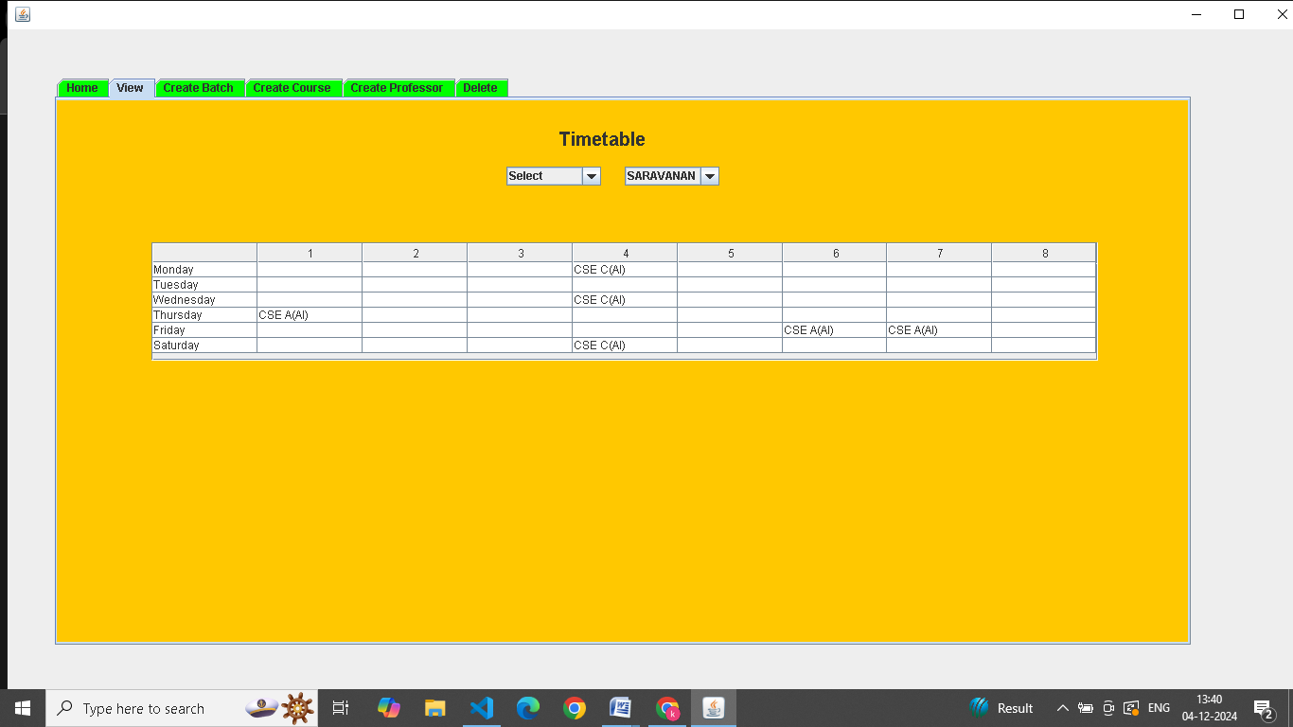
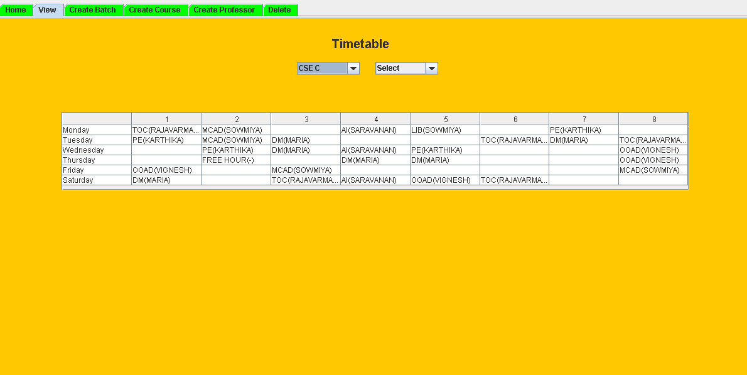
RESULTS AND DISCUSSION
GENERATED TIMETABLE FOR PROFESSOR VIEW
GENERATED TIMETABLE

Slide 16
CONCLUSION
The system automates the timetable generation process, reducing errors and administrative workload.
The project features modular components for managing batches, courses, and professors, offering flexibility and customization.
The Greedy Randomized Scheduling Algorithm ensures efficient and conflict-free timetable generation based on course and professor availability.
The system is designed for future enhancements, including database integration and export functionality.

Slide 17
THANK YOU

